Slide 1
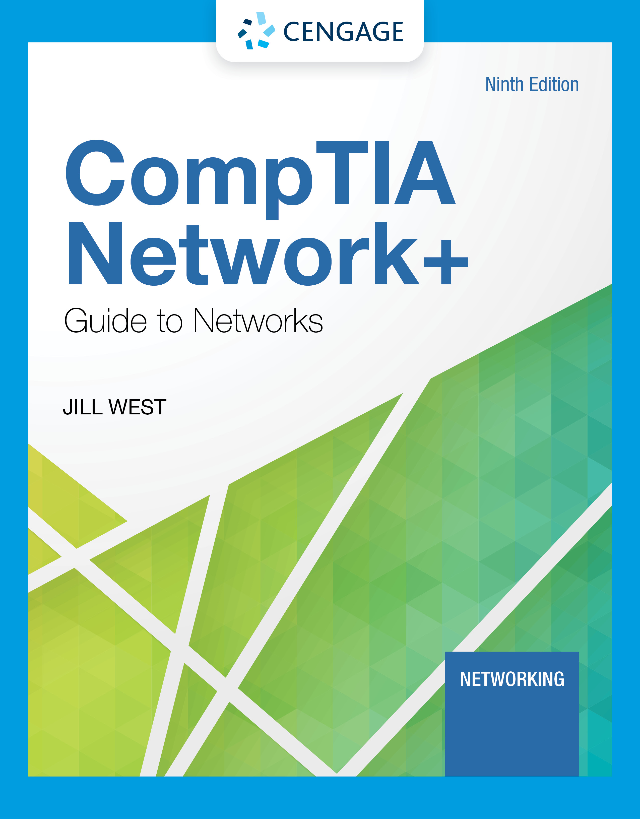
Module 2: Infrastructure and Documentation
CompTIA Network+ Guide to Networks, Ninth Edition

Slide 2
Module Objectives
By the end of this module, you should be able to:
1. Describe the roles of various network and cabling equipment in commercial buildings and work areas
2. Maintain network documentation
3. Manage changes made to a network

Slide 3
Components of Structured Cabling
ANSI/TIA-568 Commercial Building Wiring Standard
Also known as structured cabling
The wiring standard describes the best way to install networking media to maximize performance and minimize upkeep
The principles apply no matter what type of media, transmission technology, or networking speeds are involved
Structured cabling is based on a hierarchical design and assumes a network is based on the star topology

Slide 4
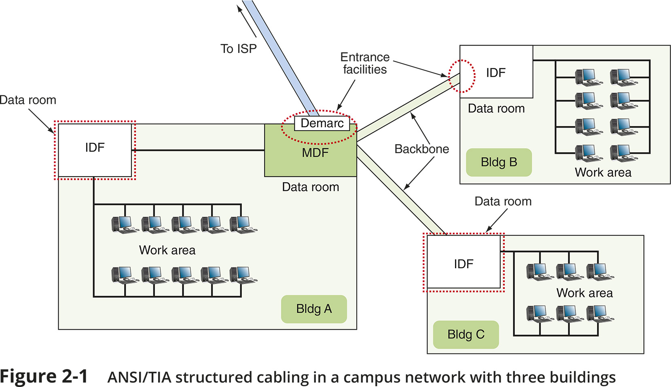
From the Demarc to a Workstation (1 of 11)
Figure 2-1 ANSI/TIA structured cabling in a campus network with three buildings

Slide 5
From the Demarc to a Workstation (2 of 11)
Entrance Facility in Building A:
EF (entrance facility) – location where the incoming network (such as Internet) connects with the school or corporate network
Demarc (demarcation point) – the device that marks where a telecommunications service provider’s network ends and the organization’s network begins
MDF (main distribution frame) – the centralized point of interconnection for an organization’s LAN or WAN (also called MC or main cross connect)
Data room – an enclosed space that hold network equipment (also called data closet, data center, equipment room, or telecommunications room)
Rack – holds various network equipment
Patch panel – a panel of data receptors which can be mounted to a wall or a rack
A patch panel provides a central termination point when many patch cables converge in a single location

Slide 6
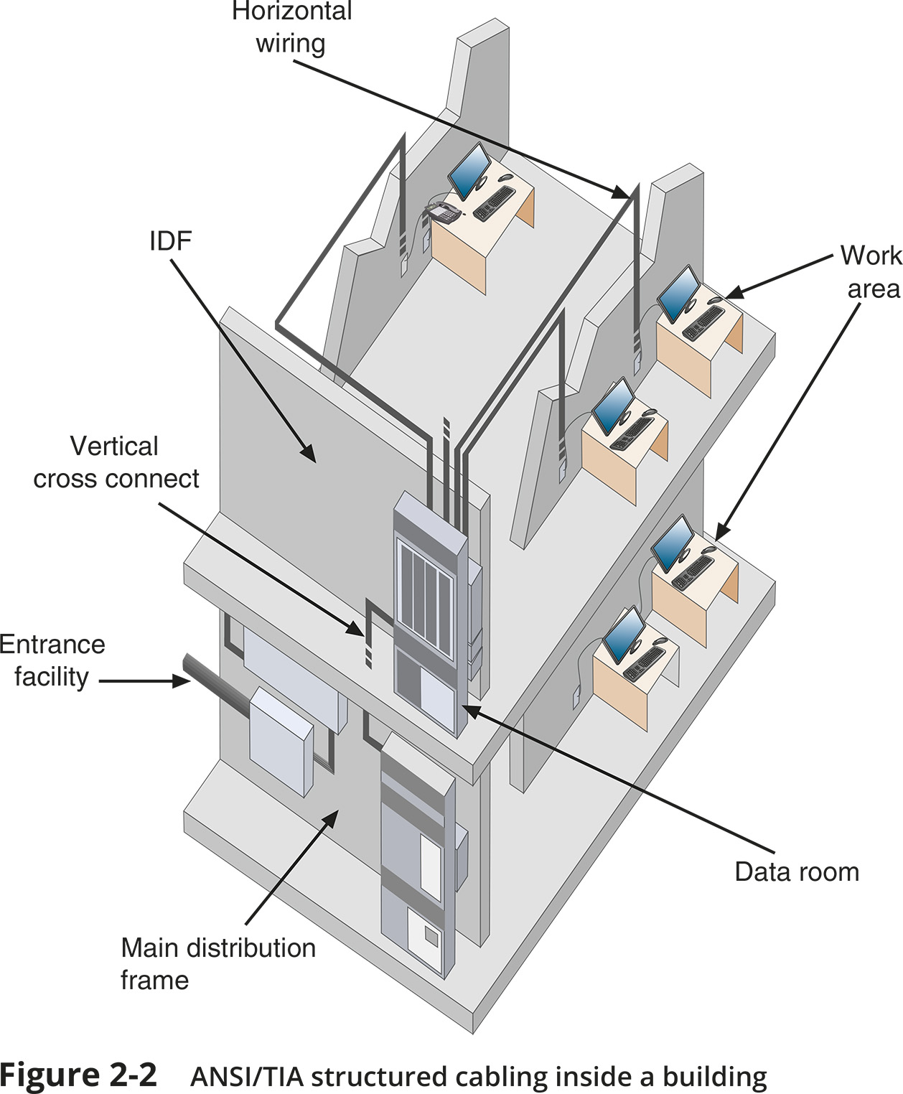
From the Demarc to a Workstation (3 of 11)
Figure 2-2 ANSI/TIA structured cabling inside a building

Slide 7
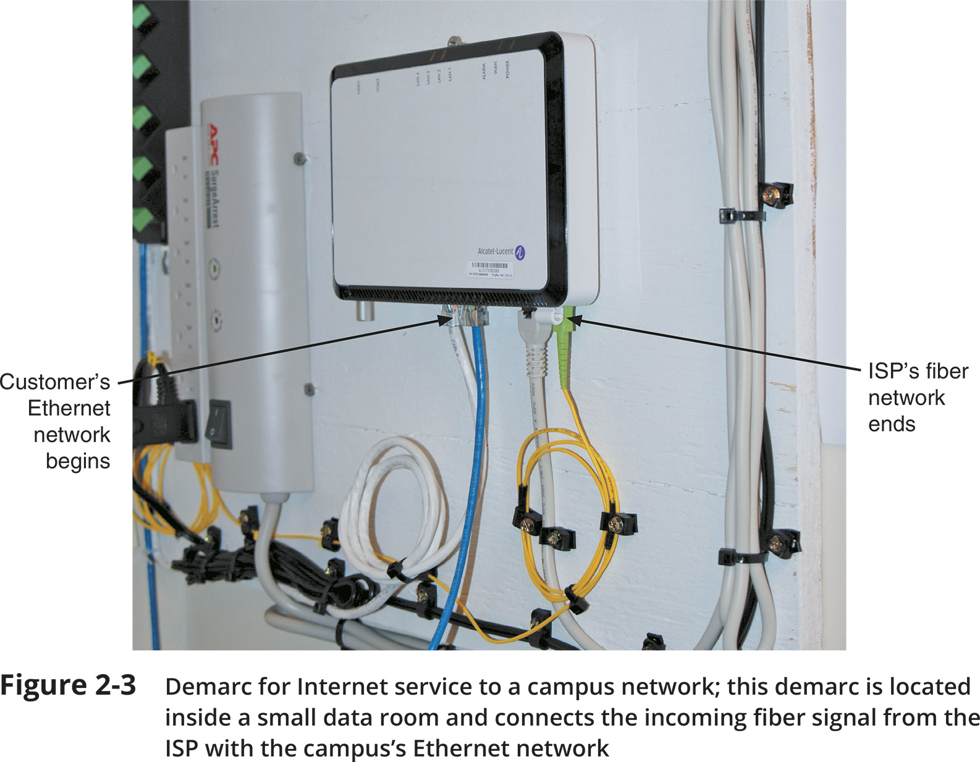
From the Demarc to a Workstation (4 of 11)
Figure 2-3 Demarc for Internet service to a campus network; this demark is located inside a small data room and connects the incoming fiber signal from the ISP with the campus’s Ethernet network

Slide 8
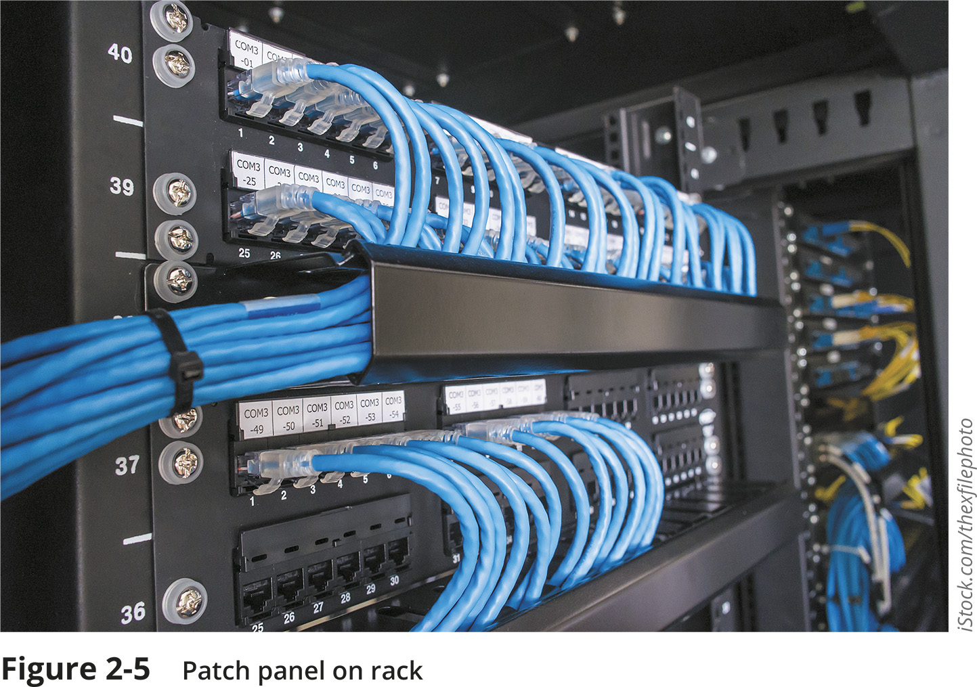
From the Demarc to a Workstation (5 of 11)
Figure 2-5 Patch panel on rack

Slide 9
From the Demarc to a Workstation (6 of 11)
Entrance Facility in Building A (continued):
VoIP telephone equipment – VoIP (Voice over IP) is the use of any network to carry voice signals using TCP/IP protocols
In one or more data rooms you might find the following:
VoIP gateway
VoIP PBX
VoIP endpoints
Data Room in Building B:
IDF (intermediate distribution frame) – provides an intermediate connection between the MDF and end-user equipment on each floor and in each building
Work Areas in All Three Buildings:
Work area – encompasses workstations, printers, and other network devices
Wall jacks – the ANSI/TIA standard calls for each wall jack to contain at least one voice and one data outlet

Slide 10
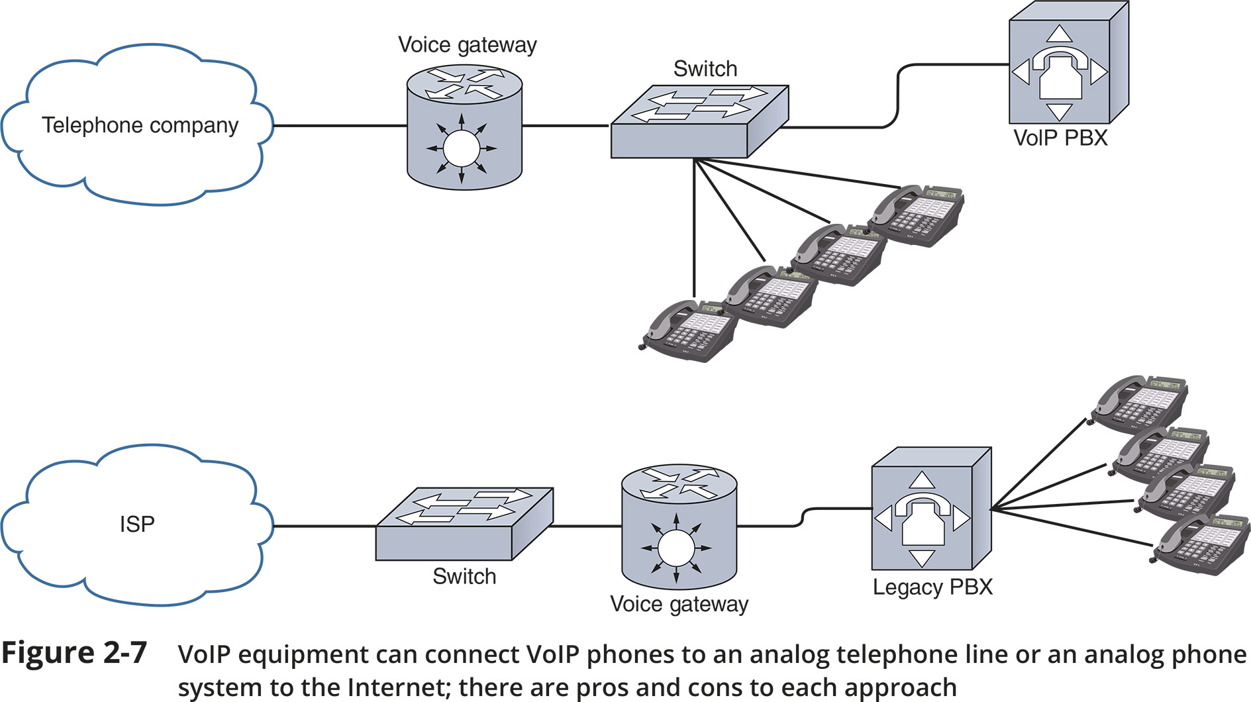
From the Demarc to a Workstation (7 of 11)
Figure 2-7 VoIP equipment can connect VoIP phones to an analog telephone line or an analog phone system to the Internet; there are pros and cons to each approach

Slide 11
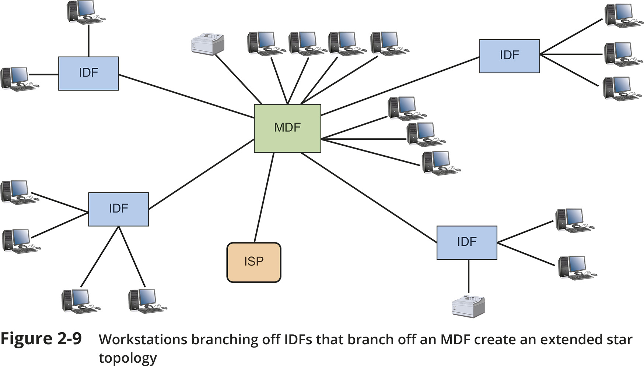
From the Demarc to a Workstation (8 of 11)
Figure 2-9 Workstations branching off IDFs that branch off an MDF create an extended star topology

Slide 12
From the Demarc to a Workstation (9 of 11)
Rack Systems
Racks come in two-post and four-post varieties (though six-post racks are also available)
Racks may be wall- or ceiling-mounted, freestanding on the floor, or bolted to the floor
Consider the following when purchasing racks:
Height – rack height is measured in rack units (RU or U) with the industry standard being 42U tall
Width – equipment racks come in a standard 19-inch frame (19 inches wide)
Depth – rack depths vary between manufacturers
In data centers containing multiple rows of racks, a hot aisle/cold aisle layout pulls cool air from vents in the floor or from low-lying wall vents into rows of racks (see Figure 2-14)

Slide 13
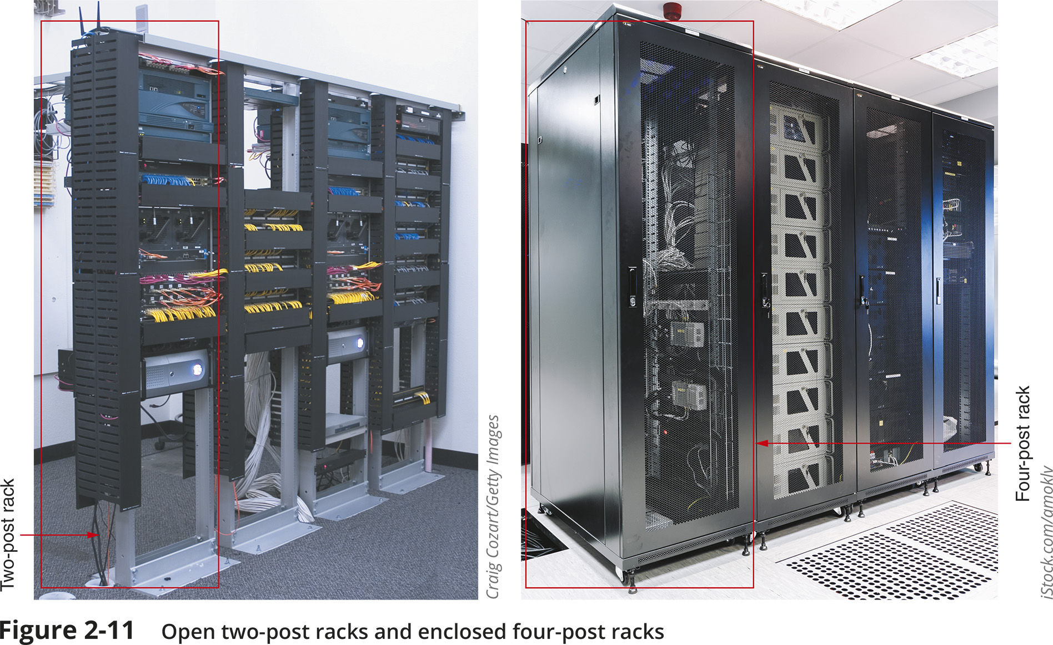
From the Demarc to a Workstation (10 of 11)
Figure 2-11 Open two-post racks and enclosed four-post racks

Slide 14
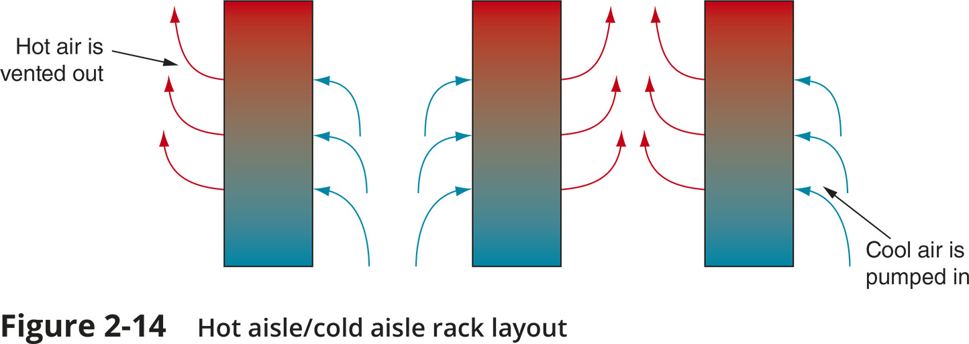
From the Demarc to a Workstation (11 of 11)
Figure 2-14 Hot aisle/cold aisle rack layout

Slide 15
Cabling (1 of 5)
Types of Cables
Patch cable – a relatively short length of cabling with connectors at both ends
Horizontal cabling – connects workstations to the closest data room and to switches housed in the room
Backbone cabling – consists of cables or wireless links that provide interconnection between the entrance facility and MDF and between MDF and IDFs
Many network problems are the result of poor cable installations
Pay close attention to the quality of cable connections and cable management

Slide 16
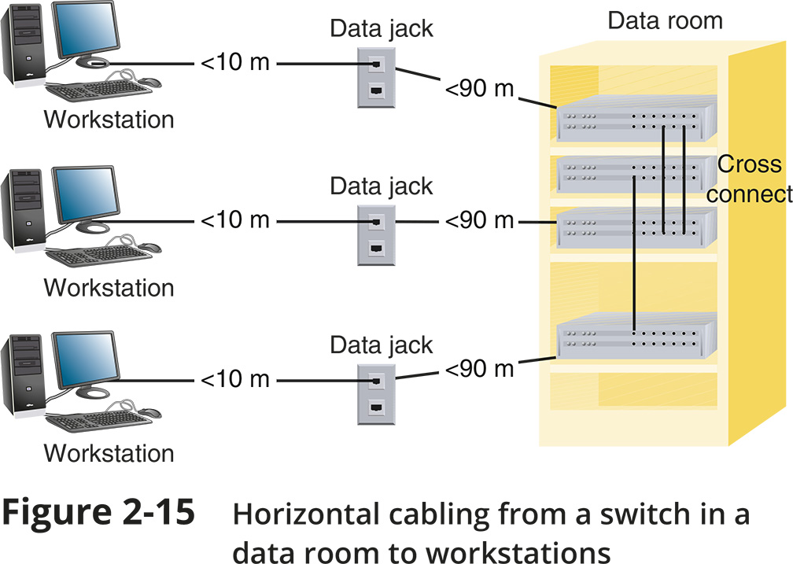
Cabling (2 of 5)
Figure 2-15 Horizontal cabling from a switch in a data room to workstations

Slide 17
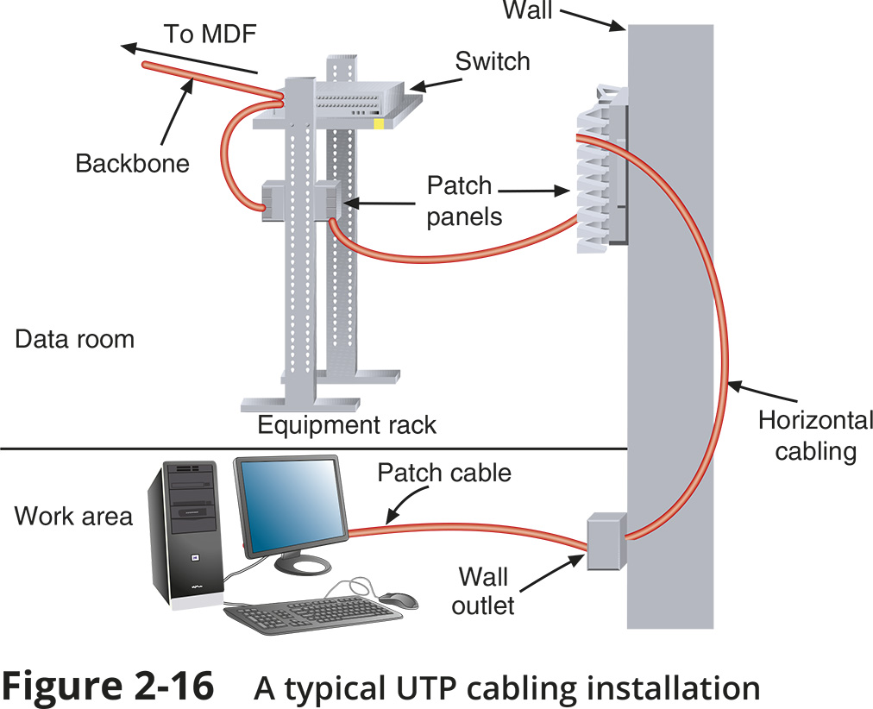
Cabling (3 of 5)
Figure 2-16 A typical UTP cabling installation

Slide 18
Cabling (4 of 5)
Cable Management
Termination – when terminating twisted-pair cabling, don’t leave more than 1 inch of exposed cable before a termination
Bend radius – do not exceed the cable’s prescribed bend radius, which is the radius of the maximum arc into which you can loop a cable without impairing data transmission
Continuity – use a cable tester to verify that each cable segment transmits data reliably
Loosely cinch cables
Cable coverings and conduits – avoid laying cables across a floor and use cord covers if they must be exposed
EMI sources – install cable at least 3 feet away from fluorescent lights or other sources of EMI (electromagnetic interference)
Plenum cabling – if running cable in the plenum (the area above the ceiling tile or below subflooring), make sure the cable sheath is plenum-rated

Slide 19
Cabling (5 of 5)
Cable Management (continued)
Grounding - pay attention to grounding requirements
Slack in cable runs
Cable trays - use cable management devices such as cable trays, braided sleeving, and furniture grommets
Patch panels - use patch panels to organize and connect lines
Company standards and inventory
Documentation
Keep your cable plant documentation accessible
Label every data jack or port, patch panel and connector
Use color-coded cables for different purposes
Update your documentation as you make changes to the network

Slide 20
Monitoring the Environment and Security
Data rooms are often serviced by HVAC systems separate from the rest of the building
Specialized products can monitor the critical factors of a data closet’s environment:
Unacceptable temperature
Humidity
Airflow conditions
Every data room should be locked with only limited IT personnel having keys
Security cameras are suggested

Slide 21
Knowledge Check Activity 2-1
Which of the following causes physical layer failures?
SCADA
PVC
STP
EMI
Notes:
Instructions:
Net+: you will choose two of the Self-Check questions from each module and re-use them for Knowledge Check Activities. The activity numbers change based on the module you are in. (e.g., 1-1 and 1-2; 2-1 and 2-2; etc.) The CM will provide you with the final page proofs from the textbook.

Slide 22
Knowledge Check Activity 2-1: Answer
Which of the following causes physical layer failures?
Answer: d. EMI
Install cable at least 3 feet away from fluorescent lights or other sources of EMI (electromagnetic interference) to reduce the possibility of noise (interference) that can affect your network’s signals at the physical layer
Notes:
Include only the question and the correct answer on the slide or include only the correct answer on the slide. The CM will provide you with the Solution and Answer Guide for the correct answers.

Slide 23
Network Documentation
Having up-to-date and detailed documentation of your network is essential for the following reasons:
Makes communication with coworkers more efficient
Speeds up troubleshooting efforts
Puts information at your fingertips when facing similar problems in the future

Slide 24
Network Diagrams (1 of 6)
Network diagrams are graphical representations of a network’s devices and connections
They may show physical layout, logical topology, IP address reserves, names of major network devices, and types of transmission media
Network mapping - the process of discovering and identifying the devices on a network
Nmap – one of the most popular tools used for network mapping
Zenmap – Nmap’s GUI option
Cisco Systems set the standard for diagram symbols used to represent network devices

Slide 25
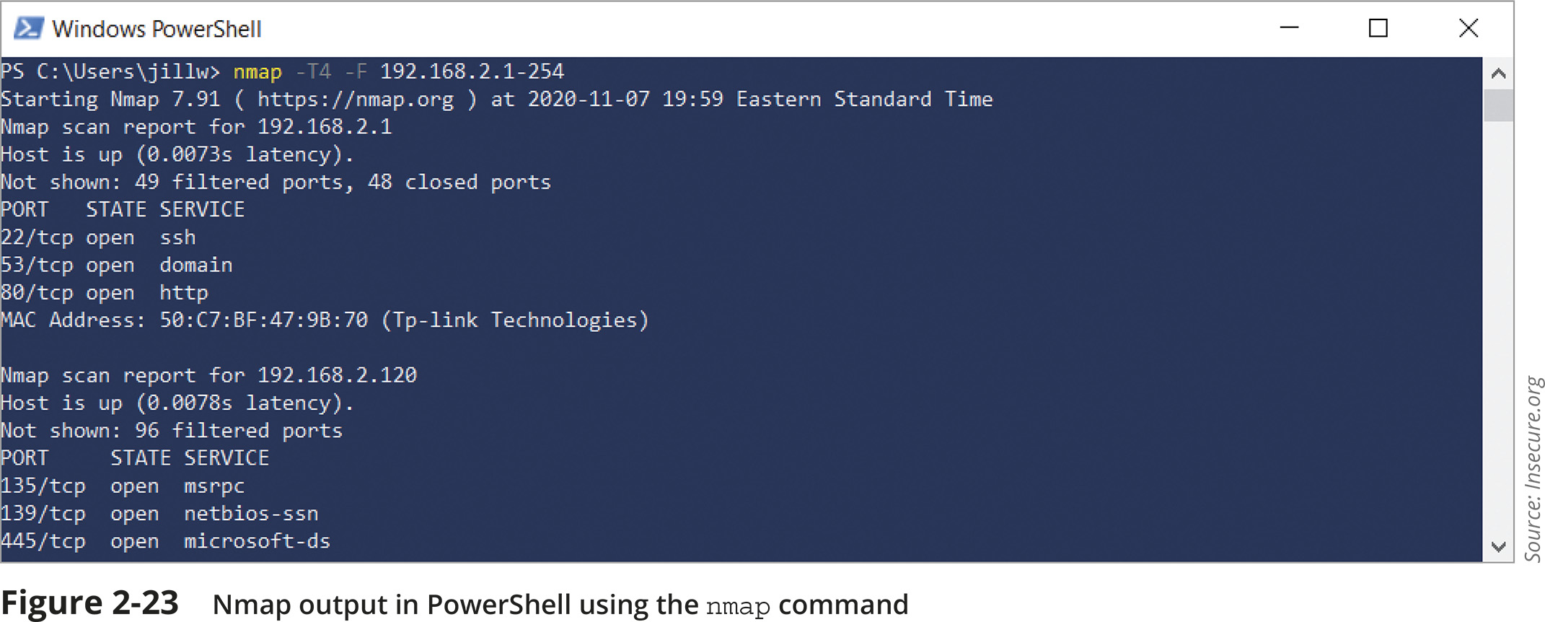
Network Diagrams (2 of 6)
Figure 2-23 Nmap output in PowerShell using the nmap command

Slide 26
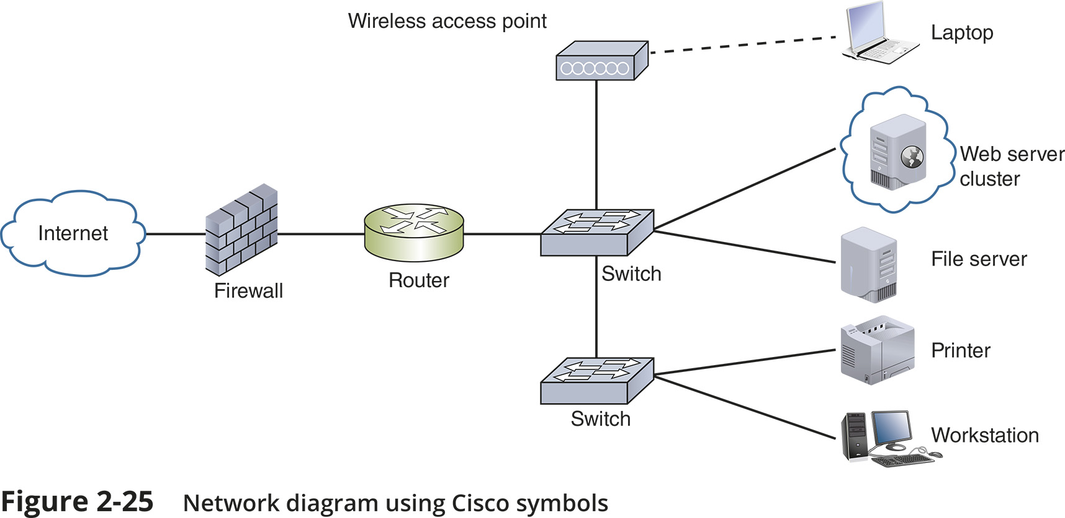
Network Diagrams (3 of 6)
Figure 2-25 Network diagram using Cisco symbols

Slide 27
Network Diagrams (4 of 6)
Network diagrams provide broad snapshots of a network’s physical or logical topology
Useful for planning where to insert a new switch or determining how a particular router, gateway, or firewall interact
Wiring schematic is a graphical representation of a network’s wired infrastructure
In detailed form, it shows every wire necessary to interconnect network devices
Rack diagram is a drawing that show devices stacked in a rack system

Slide 28
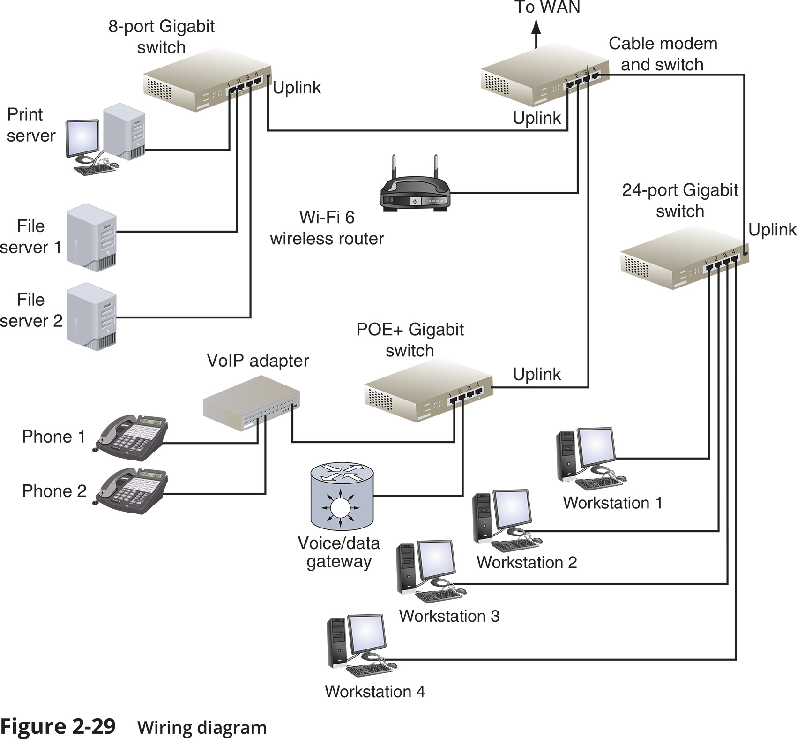
Network Diagrams (5 of 6)
Figure 2-29 Wiring diagram

Slide 29
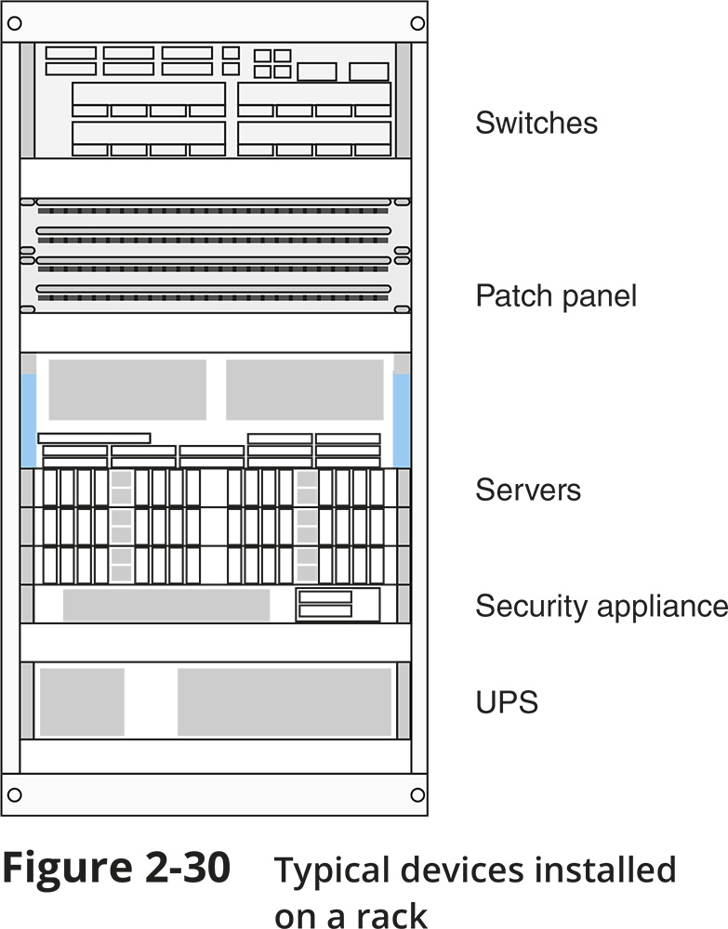
Network Diagrams (6 of 6)
Figure 2-30 Typical devices installed on a rack

Slide 30
Operating Procedures
Essential documentation:
Logical and physical connections on a network
Inventory management
IP address utilization
Vendors
Internal operating procedures
Policies
Standards
Many corporations establish SOPs (standard operating procedures) to ensure consistency
An organization could provide an internal website or database to hold this information

Slide 31
Inventory Management
System life cycle (SLC) is the process of designing, implementing, and maintaining an entire network
SLC includes:
Removal and disposal of outdated assets
Addition of compatible, updated devices
Inventory management is the monitoring and maintaining of all assets that make up a network
Simplifies maintaining and upgrading a network
Provides network administrators with information about the costs and benefits of certain types of hardware or software

Slide 32
Labeling and Naming Conventions (1 of 3)
Tips for labeling and naming conventions:
Use names that are as descriptive as possible
Only include fields that are essential in identifying the device
Don’t overcomplicate the name with useless or redundant information
Use established naming conventions
Think big-picture-down-to-details
Consider any security risks from details included in your naming convention
Use color-coded cables and use cable tags to identify each cable’s purpose
Label the ports and jacks that cables connect to
Where labels won’t fit on the device, draw a simple diagram of each device that indicates how each port is used
Use labels that are durable and are designed to stick to plastic and metal

Slide 33
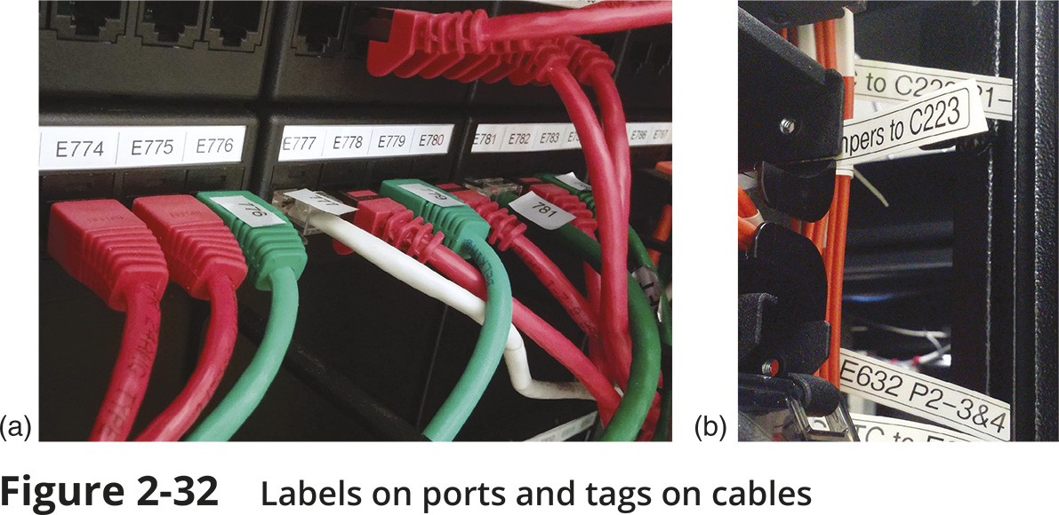
Labeling and Naming Conventions (2 of 3)
Figure 2-32 Labels on ports and tags on cables

Slide 34
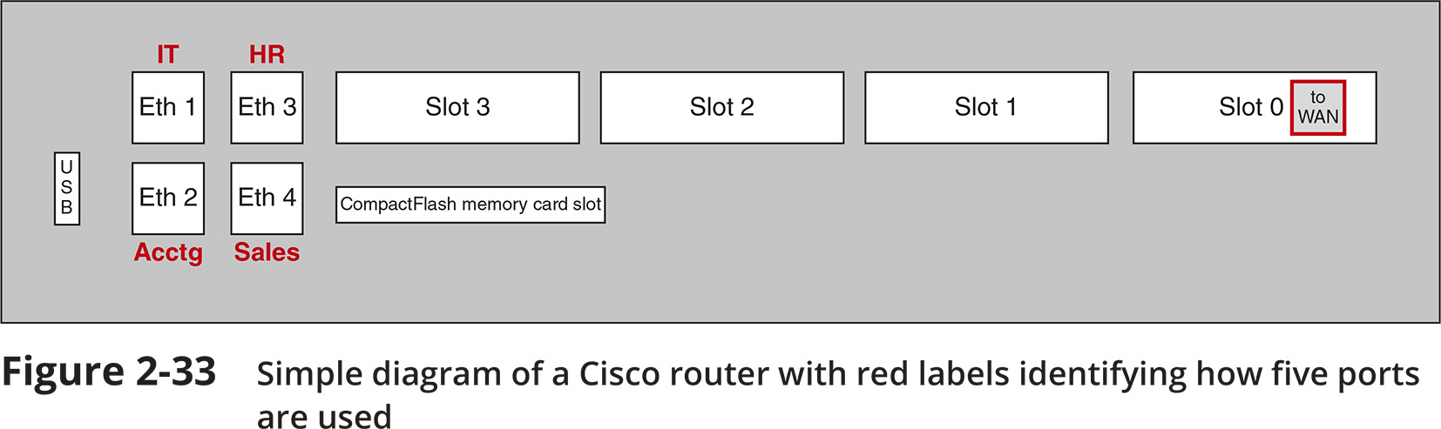
Labeling and Naming Conventions (3 of 3)
Figure 2-33 Simple diagram of a Cisco router with red labels identifying how five ports are used

Slide 35
Business Documents (1 of 2)
Standard business documents you may encounter:
RFP (request for proposal) is a request to vendors to submit a proposal for a product or service your company wants to purchase
MOU (memorandum of understanding) documents the intentions of two or more parties to enter into a binding agreement, or contract
SOW (statement of work) documents in detail the work that must be completed for a particular project
SLA (service-level agreement) is a legally binding contract or part of a contract that defines the aspects of a service provided to a customer
Example: the service provided by an ISP

Slide 36
Business Documents (2 of 2)
Standard business documents you may encounter (continued):
MSA (master service agreement) is a contract that defines the terms of future contracts between parties
Examples include payment terms or arbitration arrangements
MLA (master license agreement) grants a license from a creator, developer, or producer to a third party for the purposes of marketing or sublicensing, or distributing the product to consumers

Slide 37
Knowledge Check Activity 2-2
Which network diagram shows a logical topology?
Rack diagram
Network map
Floor plan
Wiring diagram
Notes:
Instructions:
Net+: you will choose two of the Self-Check questions from each module and re-use them for Knowledge Check Activities. The activity numbers change based on the module you are in. (e.g., 1-1 and 1-2; 2-1 and 2-2; etc.) The CM will provide you with the final page proofs from the textbook.

Slide 38
Knowledge Check Activity 2-2: Answer
Which network diagram shows a logical topology?
Answer: b. Network map
Network mapping is the process of discovering and identifying the devices on a network
Notes:
Include only the question and the correct answer on the slide or include only the correct answer on the slide. The CM will provide you with the Solution and Answer Guide for the correct answers.

Slide 39
Change Management
Managing change while maintaining network’s efficiency and availability requires good planning
Network users need to know when to expect certain network resources to be unavailable
Common software and hardware changes range from installing patches to replacing network backbone
You may also need to know the change management documentation that might be required for an enterprise-scale network

Slide 40
Software and Hardware Changes (1 of 2)
Four types of software changes:
Installation – new software to be installed on relevant devices and incorporated with network resources
Patch – a correction, improvement, or enhancement
Upgrade – a major change to a software package that enhances the functionality and features of the software
Rollback – also called backleveling or downgrading
Process of reverting to a previous version after attempting to patch or upgrade it
Hardware changes could include adding new security cameras, replacing workstations, installing new printers, and upgrading hardware

Slide 41
Software and Hardware Changes (2 of 2)
The same change management principles apply to any type of change:
Process all changes through the proper channels
Minimize negative impacts on business procedures
Plan thoroughly to maximize the changes of a successful change on the first attempt
Document each change throughout the process

Slide 42
Change Management Documentation
Generally, the larger an organization, the more documentation required when making changes
You may need to do the following:
Submit a change request document
Understand and follow the approval process
Follow project management procedures
Provide additional documentation that could include:
Network configuration
IP address utilization
Additions to the network
Physical location changes
Close the change

Slide 43
Summary
Now that the lesson has ended, you should be able to:
Describe the roles of various network and cabling equipment in commercial buildings and work areas
Maintain network documentation
Manage changes made to a network

